Slide 1
Water Heater Element
Made By:-
1- Youssef Mohamed Ismail
2- Mo'men
3- Omar Azam

Slide 2
Introduction
In our daily life we use water for different activities in all bases of life.
We use water for cleaning ,cocking ,washing and much more.
The usage of water may differs so, we need water to vary in temperature as usage and seasons changes.
With our advanced technologies we develop really fast ways to control the temperature of water precisely as we need it.

Slide 3
Components
24C08 EEPROM, or use the internal.
Temp sensor (LM35, or equivalent DS18B20).
Cooling Element (Peltier).
Heating Element (3d ceramic heater).
7-segments.
LEDs.
Push Buttons.
Solid State Relays.
Cooling fins & fans.

Slide 4
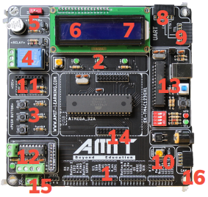
AMIT Microcontroller
Major Features:-
Microprocessor Atmega32
Oscillation Crystal of frequency 16MHz
RESET Button
PC connector
And other helpful tool and components

Slide 5
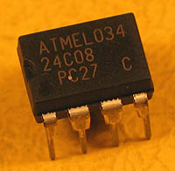
EEPROM 24C08
EEPROM (Electrically Erasable Programmable Read-Only Memory) is non-volatile memory.
It retains data even when power is turned off.
EEPROMs can be electrically erased and reprogrammed.
Commonly used in storing configuration settings, calibration data, and user preferences.
Found in various electronic devices such as computers, consumer electronics, and sensors.

Slide 6
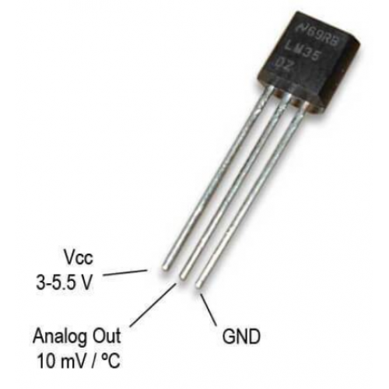
Temp. Sensor LM35
The LM35 is a precise temperature sensor with a linear output proportional to Celsius temperature.
It requires no calibration and offers high accuracy over a wide temperature range.
Commonly used in various applications due to its simplicity, accuracy, and affordability.

Slide 7
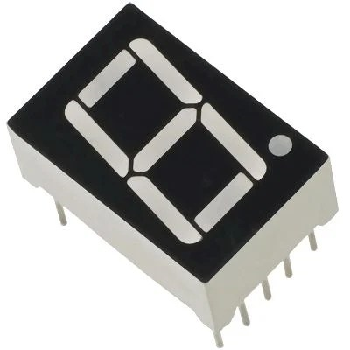
7 - Segments
Electronic display with seven segments.
Displays numbers, letters, or symbols.
Used in digital clocks, timers, etc.
Operates with LED technology.
Interfaces with microcontrollers for control.

Slide 8

Heating Element 3d ceramic heater
Ceramic heating element with 3D design.
Ensures efficient heat distribution.
Rapid heating and precise temperature control.
Used in space heaters, hair dryers, etc.
Energy-efficient and durable.
Ideal for heating small to medium-sized spaces

Slide 9
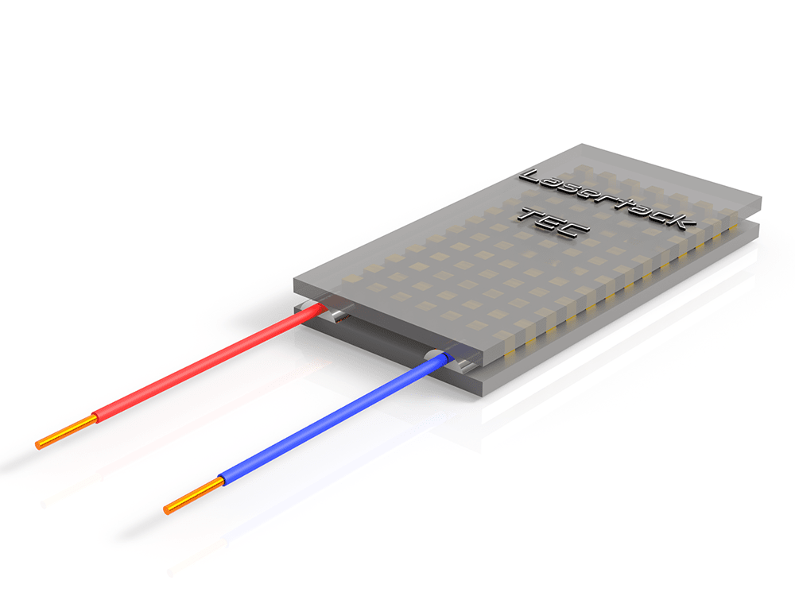
Cooling Element Peltier
Thermoelectric device.
Generates temperature difference.
Used for cooling or heating.
Common in refrigeration and electronics.
Compact, reliable, and precise.
Maintenance-free and eco-friendly.

Slide 10
Mechanism
Temperature Setting
The “Up” or “Down” buttons are used to change the required water temperature (set temperature).
The first “Up” or “Down” button press, enters the temperature setting mode.
After entering temperature setting mode, a single “Up” button press increase the set temperature by 5 degrees.
After entering temperature setting mode, a single “Down” button press decrease the set temperature by 5 degrees.
The minimum possible set temperature is 35 degrees.
The maximum possible set temperature is 75 degrees.
The “External E2PROM” should save the set temperature once set.
If the electric water heater is turned OFF then ON, the stored set temperature should be retrieved from the “External E2PROM”.
The initial set temperature is 60 degrees.
ON/OFF Behavior
If power is connected to the heater ,The electric water heater is in OFF state.
If the “ON/OFF” button is released and the electric water heater is in OFF state, the electric water heater goes to ON state.
If the “ON/OFF” button is released and the electric water heater is in ON state, the electric water heater goes to OFF state.
In the OFF state, all display should be turned OFF.

Slide 11
Mechanism
Temperature Sensing
The temperature sensor measures the water temperature.
The water temperature should increase, if the “Heating Element” is ON.
The water temperature should decrease, if the “Cooling Element” is ON.
Temperature should be sensed once every 100 ms.
The decision to turn ON or OFF either the “Heating Element” or the “Cooling Element” based on the average of the last 10 temperature readings.
Heating/Cooling Elements
The “Heating Element” should be turned ON, if the current water temperature is less than the set temperature by 5 degrees.
The “Cooling Element” should be turned OFF, if the current water temperature is less than the set temperature by 5 degrees.
The “Heating Element” should be turned OFF, if the current water temperature is greater than the set temperature by 5 degrees.
The “Cooling Element” should be turned ON, if the current water temperature is greater than the set temperature by 5 degrees.

Slide 12
Mechanism
Seven Segments
Seven segment by default show the current water temperature or the set temperature
By default, the 2 seven segment display are show the current water temperature.
If the electric water heater is in the temperature setting mode, the 2 seven segment displays should blink every 1 second and show the set temperature.
In the temperature setting mode, every change in the set temperature should be reflected on the 2 seven segment displays.
The 2 seven segment display should exit the temperature setting mode, if the “UP” and “Down” buttons are not pressed for 5 seconds.
Heating Element Led
If the “Heating Element” is ON, the “Heating Element Led” should blink every 1 second.
If the “Cooling Element” is OB, the “Heating Element Led” should be ON.

Slide 13
THANK YOU

